Slide 1
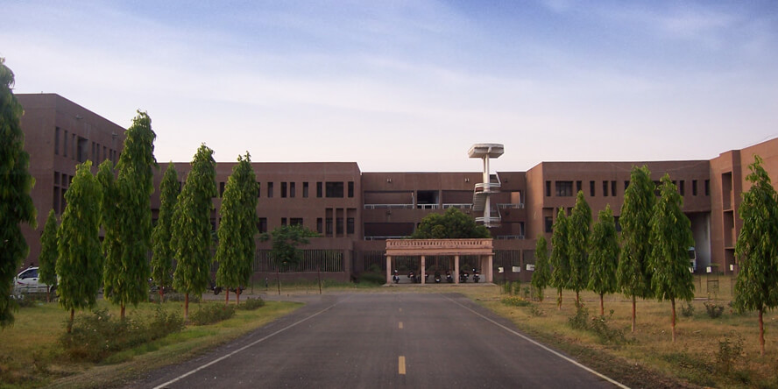

Institute of Engineering & Technology,
Sitapur Road, Lucknow (UP)- 226021
Placement Brochure
Department of Chemical Engineering

Slide 2
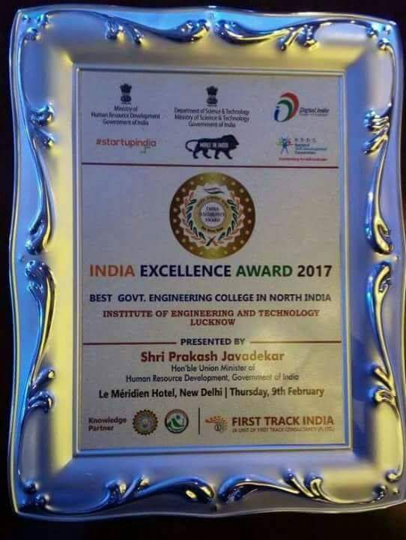
Moment of Honour
It gives us immense pleasure and honour to announce that our institute has been awarded with the "India Excellence Award 2017" for the Best government college in North India, by the Ministry of Human Resource Department (MHRD), Government of India.

Slide 3
Content
Message from Head Of Department
About the Department
Faculty Members
Lab and Facilities
Courses offered
Technical Clubs And Activities
Student Projects
Past Recruiters
Workshops & Internships
Contact Us

Slide 4
Message from Head Of Department
The department of Chemical Engineering at IET Lucknow, is committed to excellence in chemical engineering education in the context of the evolving discipline. The department has a strong inter-disciplinary core curriculum complemented by some specialized courses that include Petroleum Refining Engineering, Fertilizer Technology, Hazard and Safety Analysis, Design Catalytic Reactors, Advanced Separation Technique, High Polymer Technology, Surface Coating and Technology, Oil Technology, Biochemical Engineering. Research is an important focus of activity and the department has an excellent faculty who lead high quality research programmes in a wide spectrum of areas.
We emphasize on the importance of teamwork and value what each and every student, staff, and faculty member brings to the learning environment. Our goal is to instill in our students that their actions have impact both in what they produce as engineers and how they choose to live their lives in society--and that they can and will make a difference in the world upon graduation. The department is provided with very good experimental facilities for research and a strong technical staff. I am proud of our faculty in that each of them is a role model who inspires our students to be the best engineers and people they can be. Our alumni, have distinguished themselves both in academia and industry and have continued to inspire and support our current generation of students.
I, thereby, invite you to visit our Chemical Engineering department and see for yourself the unique environment and support we provide our students. I highly value our partnership with recruiters and friends of IET Lucknow and would remain committed towards making your recruiting experience productive and positive.
Dr. R P Ram
Head, Dept. of Chemical Engineering

Slide 5
About the Department
The department offers an academic programme leading to B.Tech degree in chemical engineering. The department has a highly qualified faculty to guide the students at every step. The department has strength of highly qualified faculty, which give their valuable guidance to the students. Department headed by Shri R.P Ram..
The curriculum is fully updated and meets the industry requirements and trends in the industry. The electives provide an opportunity to the students to hone their practical skills and strengthen their practical and theoretical base.
The students who engage themselves in project work, seminars and have periodic visits at various research institutes.
Core curriculum : It offers a well-planned and balanced curriculum to enable students to cope up with the latest knowledge and rigorous industrial trends.
Electives : Along with inter-disciplinary core courses, the department offers some specialized courses that include Petroleum Refining Engineering, Fertilizer Technology, Hazard and safety analysis, design catalytic reactors, advanced Separation technique, high polymer technology, Surface coating And technology, oil technology, Biochemical Engineering.

Slide 6
Faculty Members
Dr Ram Pravesh Ram Computational Fluid Dynamics, Non-Newtonian Flow, Modeling and Simulation, . Separation Processes
Dr. Dhananjay Singh Bioenergy, Environmental Biotechnology, Renewable Energy
Dr. Pradeep Kumar Separation Process, Modular Modeling, Green Chemistry
Dr. Basudhrity Banerjee Alternative Fuels lithium ion batteries and electrolyte recovery, Hydrogen Storage . material, Ionic liquids, Molecular dynamics and Simulation, Plant designing
Dr. Rakesh Baghel Hydrodynamics of helical and Spiral coils, Waste water treatment, Membrane . based separation technology, Chemical reaction engineering
Dr. Vijay Singh Ceramic Membrane Fabrication and its application of Oil water representation , . Clean Coal Technological and Fruit Juice, Classification and Storage Study
Dr. Brajesh Kumar Modeling and Simulation of chemical engineering System, Waste water . treatment, Chemical Reaction Engineering, Chemical Engineering .
Mr. Upendra Kumar Shukla Computation Fluid Dynamics, Outside Vapor Deposition, Process Modeling . Simulation, Modeling and Simulation of Mass Transfer Equipment, Numerical . . Computation for Research
Ms. Ankita Sharma Waste water treatment, Chemical Reaction Engineering, Mass Transfer, Heat . Transfer

Slide 7
Lab And Facilities
The department has many laboratories that are fully-equipped and well maintained. These laboratories not only enhance the practical skills, but also strengthen the theoretical concepts. The various laboratories in the department include:
Fluid mechanics and particle laboratory
Heat transfer lab
Mass transfer laboratory having computerized distilling column
Chemical reaction engineering laboratory having plug flow reactor
CSTR along with Batch Reactor
Process instrumentation lab with experiments on proportional controller, PI controller, PID controller etc.
CAD laboratory
For project reports, seminar works or for knowledge of latest developments, the students continuously visit CDRI, CMAP and CSIR. Every year a good percentage of students employed in reputed companies and pursue higher studies. With hard and proper guidance of faculty members, the students make their way to IISC, IITs and BARC.

Slide 8
Courses Offered
Chemical Reaction Engineering
Chemical Technology
Computational Fluid Dynamics
Environmental Pollution Monitoring and Control
Fluid Mechanics
Heat Transfer
Intellectual Property Rights and Standardization
Mass Transfer Operations
Mechanical Operations
Numerical Methods for Chemical Engineering
Optimization Technique
Process Calculation
Process Design and Control
Process Design and Economics
Process Flow Sheet Simulation
Process Integration
Process Utility and Safety in Chemical Plants
Statistical Design Of Experiments
Thermodynamics

Slide 9
Technical Clubs And Activities
CHESS
The Chemical Engineering Student’s Society was formed with the purpose to develop better relationships and foster a community in which people can work in a better way towards achieving their goals. The society’s basic aim is channelized flow of knowledge and information from the respected faculty advisors to the senior students and thereby to the juniors.
It organizes annual conferences and workshops, thereby, ensuring to provide an excellent forum for both general lectures and more specialized presentations by eminent personalities of different organizations and Institutes.
The society, also organizes Paper presentations to nurture the ability of student to present their ideas.
Organizes annual branch festival ALCHEMY which covers different technical events like Frugal Engineering, .Chem-E-Car, Quizzes , Seminars etc. so that the competitions bring out the best in each student.
ALCHEMY
It started with the aim of providing a platform for the IET student community to develop and showcase their technical as well as cultural abilities. The underline spirit of ALCHEMY was “To establish harmony and solidarity among juniors and seniors” a motto that has been followed by every ALCHEMY member since.
The activities culminate in a grand three days festival events in the campus.

Slide 10
Workshops and Industrial Visits
Workshop on Advances in Chemical Engineering And Technology
Coordinator: Dr.Pradeep Kumar
Expert Lecture: Prof. Rajesh Khanna, IIT Delhi
Dr. Dharm Pal, NIT Raipur
Dr. Vimal Chandra Srivastava, IIT . Roorkee
Dr. S K Saraswat, JNV, Jodhpur . University
Dr. Avinash Chandra, TIET, . Patiala
Dr. Ritunesh Kumar, IIT Indore
Dr. Rakesh Kumar, RGIPT . Raibareily
Dr. Abhishek Chandra, UIET, . Kanpur
Industrial Visit to BASF India Ltd.
Workshop on Renewable Energy and Environment
Coordinator: Dr. Dhananjay Singh
Expert Lecture: Prof. S K Awasthi, HBTI Kanpur
Prof. Anil Verma, IIT Delhi
Prof. I D Mall, IIT Roorkee
Dr. Rahul Dev, MNNIT Allahabad
Prof. Shishir Sinha, IIT Roorkee

Slide 11
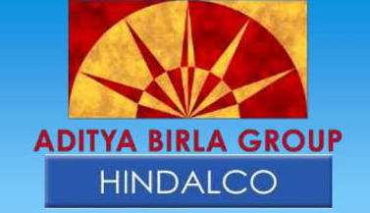














Internships

Slide 12









Previous Recruiters

Slide 13
Contact Us
Institute Of Engineering And Technology
Sitapur Road, Lucknow 226021
Dr. Arun Kumar Tiwari
In-Charge
Training and Placement Cell
Email: aruntiwari@ietlucknow.ac.in
Amit Gautam
Student Representative
Training and Placement Cell
Mob: 9462255426
Email: amitgautam.che@gmail.com

